Slide 1
PARAPHRASING
Techniques
Tactics to
rewrite something
in a
different way

Slide 2

Paraphrasing
To paraphrase is to say the same thing in another way, using your own words.
We can successfully paraphrase by using a combination of techniques.

Slide 3
Paraphrasing Techniques
Change from a Clause to a Phrase (or vice versa)
Change from Quoted Speech to Indirect Speech (or vice versa)
Change from Active Voice to Passive Voice (or vice versa)
Change to Synonyms
Change Word Forms

Slide 4


Change from a Clause to a Phrase
After he studied, John took a nap.
After studying, John took a nap.
The house across the street is new.
The house that is across the street is new.

Slide 5
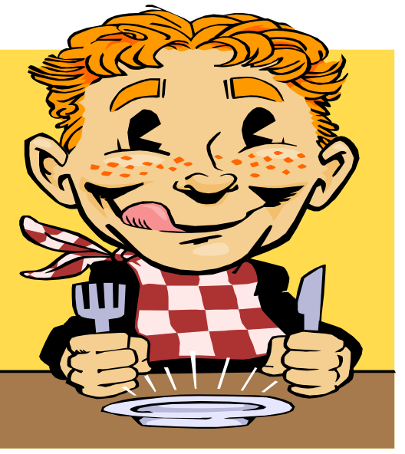
Change from Quoted Speech to Indirect Speech
Mr. Lee said, “I am ready for lunch.”
Mr. Lee said he was ready for lunch.
“I am ready for lunch.”

Slide 6
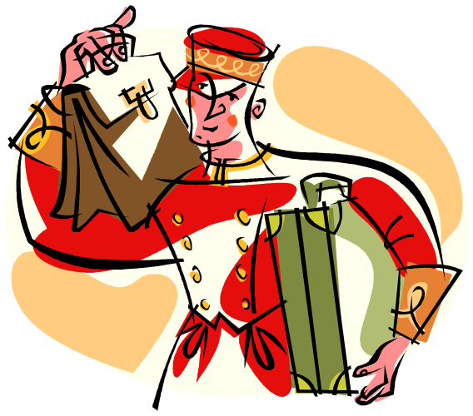
Change from Active Voice to Passive Voice
A hotel employee will carry your bags.
Your bags will be carried by a hotel employee.

Slide 7
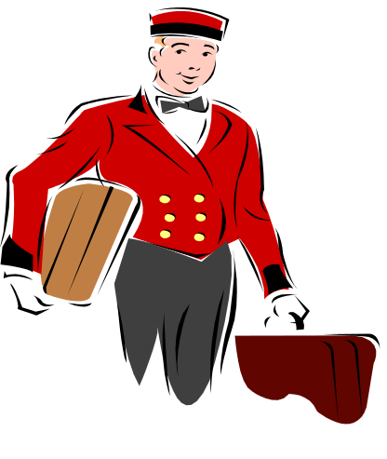
……and replace words with synonyms.
A hotel employee will carry your bags.
Your bags will be carried by a hotel employee.
Your luggage will be picked up by a bell boy.

Slide 8

Change Word Forms
Use an adverb instead of an adjective
Use a verb to replace a noun.
GROG is an accurate typist.
GROG types accurately.

Slide 9

Change to Synonyms
Replace the original words with words
that mean the same.
The stallion was content with the mare.
The stallion was happy with the mare.

Slide 10

When You can’t find a Synonym
Replace the original word with a definition.
The stallion was content with the mare.
The male horse was happy with the female horse.

Slide 11
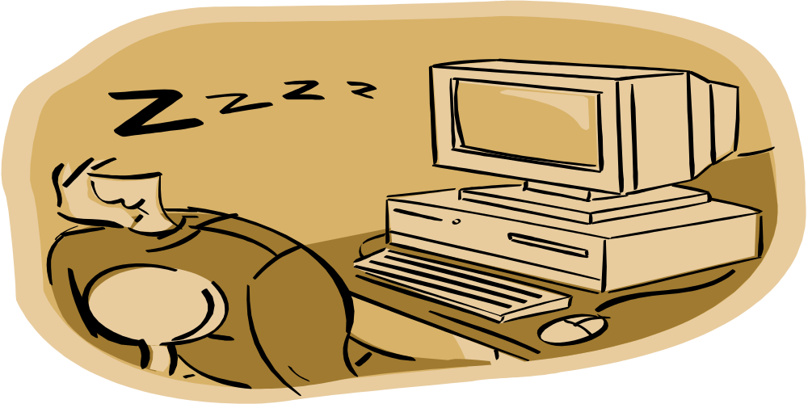
Combine Techniques
Change to a phrase & add synonyms or definitions
After he ate lunch, Mike took a nap.
After eating lunch, Mike slept a little.

Slide 12
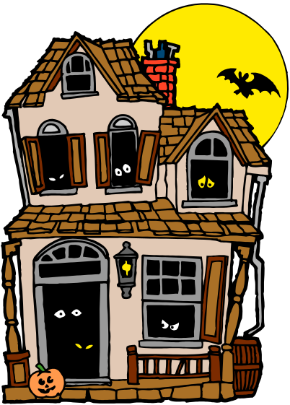
Combine Techniques
Change to a phrase & add synonyms or definitions
The house that is across the street is old.
The house across the street is old.
The house on the other side of the street is old.
The dwelling on the other side of the road is ancient.

Slide 13


Interpret Meaning…….Identify the underlying meaning of a statement.
The wolf said, “I am ready for lunch.”
The sheep looked very worried.
The wolf complained about being hungry which made the sheep extremely anxious.
I am ready for Lunch

Slide 14
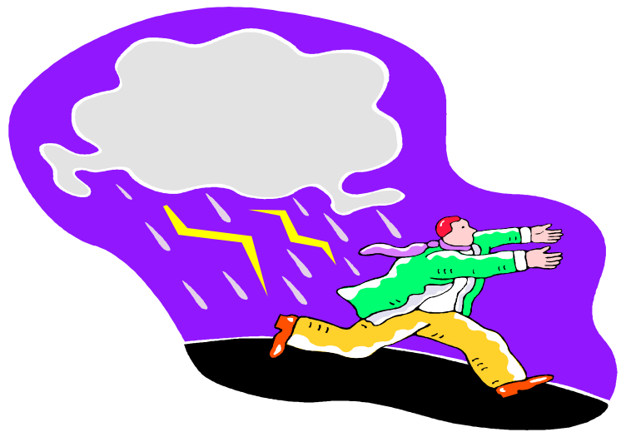
Change transitions
Although it was raining, Bob walked to work.
It was raining, but Bob walked to work.
It was raining; however, Bob walked to work.

Slide 15
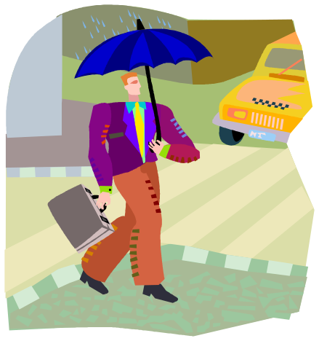
…… and change word forms
Although it was raining, Bob walked to work.
It was raining, but Bob walked to work.
It was raining; however, Bob walked to work.
Despite the rain, Bob went to work on foot.

Slide 16
☺Your Turn☺
Paraphrase the following:
Today, people are worried about internet security. Advocates of internet tracking believe that it helps marketers to understand what people want. People who oppose internet tracking believe that it is an invasion of privacy. This information age will cause more and more people to become concerned with the level of personal detail that can be found from the internet.

Slide 17
People are concerned about internet security today. Internet tracking proponents contend that it aids in the understanding of consumer preferences by marketers. Internet tracking is opposed by many who consider it to be an infringement of privacy. The amount of personal information that can be gleaned from the internet will worry more and more individuals as we move deeper into the digital era.

